Slide 1

Comparative Study of Demand Forecasting Models
Balabhadra Krishna Chaitanya
2019A4PS1500H

Slide 2
Introduction
Demand forecasting is the process of making estimations about future customer demand over a defined period, using historical data and other information.
Proper demand forecasting gives businesses valuable information about their potential in their current market and other markets.
Helps managers to make informed decisions about pricing, inventory levels,business Strategy.

Slide 3
Steps in making a Forecasting model
Determine the objective and use of the forecasting model
1
Choose the parameter that needs to be forecasted
2
Determine the forecast's time horizon.
3
Collect the relevant information to make the forecast
4
Choose an appropriate forecasting model
5
Perform the forecast
6
Validate and verify the results
7

Slide 4
Step-1 Objective of the Forecast model
"Milkman," a milk producing company which was well established and acquired a significant portion of the market due to its superior quality and affordable pricing in comparison to its competitors.
The Company has the plan to expand its current capacity so it can tap the unorganized market as well. So, it needs to build a new plant in order to achieve this.
The corporation set a task to a data analyst to predict sales of milk (in liters sold) leaving the production plant. And recommend best statistical/machine-learning model.
Also, recently many stockouts have been reported at various distribution centres. The management failed to assess the demand properly.

Slide 5
Step-2 To choose the parameter that needs to be forecasted
As, the company wants to project its sales. So, I used past year sales data (number of liters sold) of the company.
Step-3 To Determine the forecast's time horizon
As the Company wants to expand its current capacity which is a capital expenditure .Therefore, we should go for Longterm forecast.
We have monthly sales data on the amount of milk sold during the preceding 12 years.

Slide 6
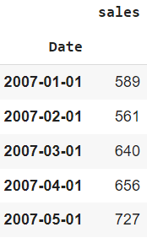
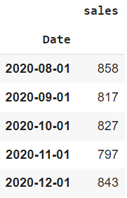
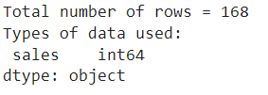
Step 4 Data Pre-Processing and Analysis
Pre-Processing steps include
Cleaning the data (I.e., convert proper date format that python can understand)
Dropping the missing values in the data.

Slide 7
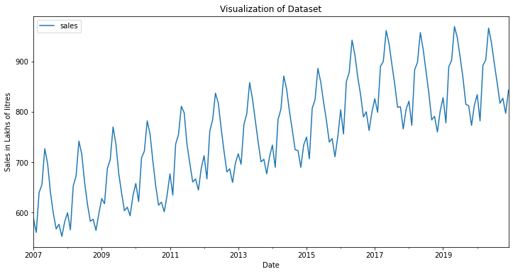
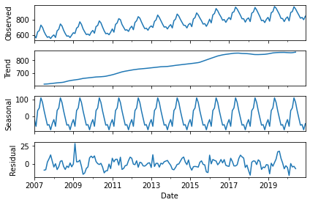
Visualization of the dataset
Seasonal Decomposition of the dataset

Slide 8
Step 5 Proposed Methodology for selecting best model
Jupyter Notebook is used for conducting the analysis.
For the sales data, four models will be used: Simple regression, Holt's Winter Exponential smoothing model, SARIMA, and RNN.
The dataset was divided into test and train in 20:80 ratio.
Each test data was plotted, and projections for the four models were generated for the next 36 months.
The forecast numbers were then compared to the previously withheld actual data and forecast error metrics were computed.(namely MSE, MAD, and MAPE

Slide 9
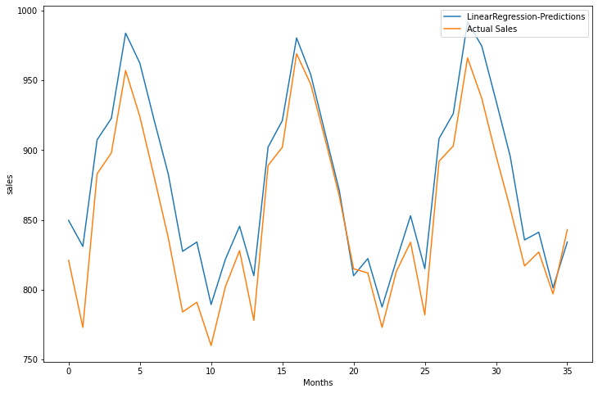
Linear Regression
Data needs to be stationary before training the model. It is made stationary using differencing method then converted to Numpy array and fed into model.
Mean Squared Error : 27.23522
Mean Absolute Deviation: 23.50306
MAPE: 2.78069

Slide 10
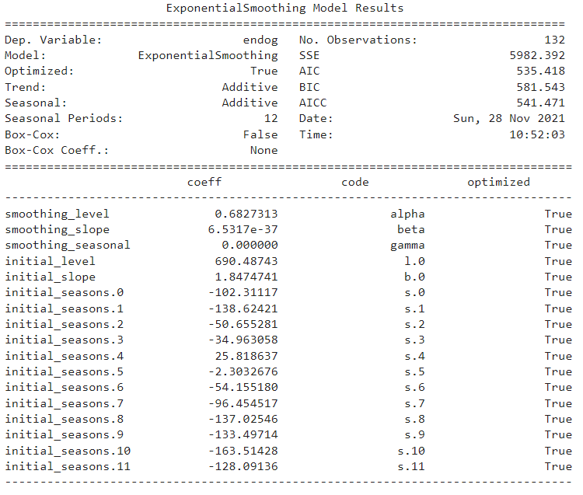
Holt’s Winters Exponential Smoothing Model
The forecast equation and three smoothing equations — one for the level, one for the trend, and one for the seasonal component — make up the Holt-Winters seasonal technique. ,with the correct smoothing parameters
Mean Squared Error : 32.38790
Mean Absolute Deviation: 29.31068
MAPE : 8.55139

Slide 11
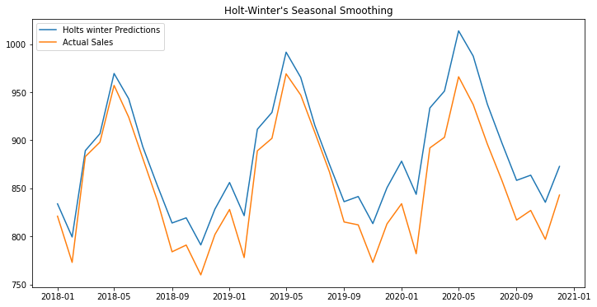

Slide 12
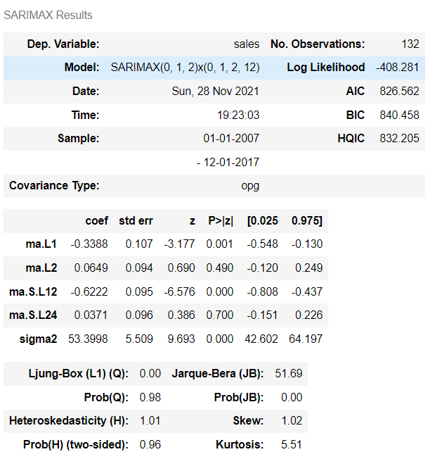
Seasonal ARIMA Model
SARIMA has three parameters which govern the prediction accuracy; these are P,D,Q and M.
P is the order of the Autoregression model,D is the order of differencing to get the stationary data,Q is the order of the moving average model and m is the order of periodicity.
Mean Squared Error : 34.97381
Mean Absolute Deviation : 32.68459
MAPE : 8.74879

Slide 13
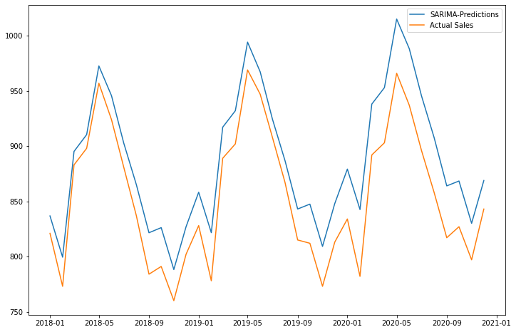

Slide 14
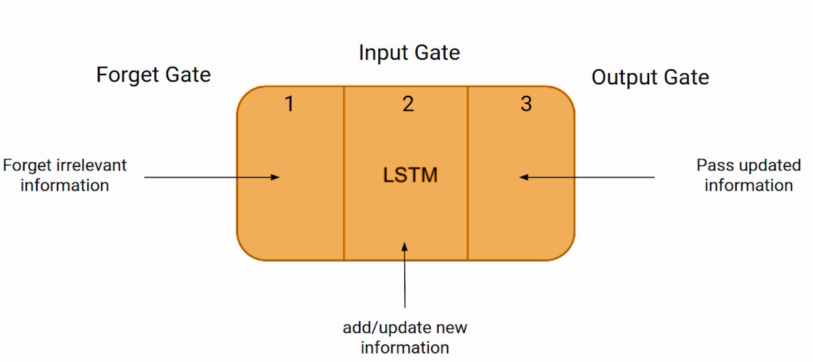
LSTM
LSTM is a type of recurrent neural network.
Recurrent Neural networks are special types of neural networks designed for sequence problems.
In the LSTM, each neuron is a memory cell that connects prior data to the current neuron.

Slide 15
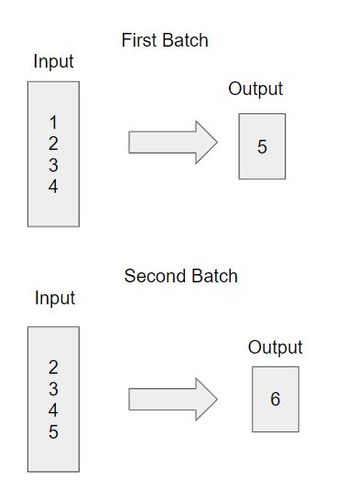
Working of LSTM
LSTM contain epochs that feed the network activations from a previous time step as inputs to the network.
The prediction along with the input is again fed into another epoch and in this way learn patterns from the data.

Slide 16
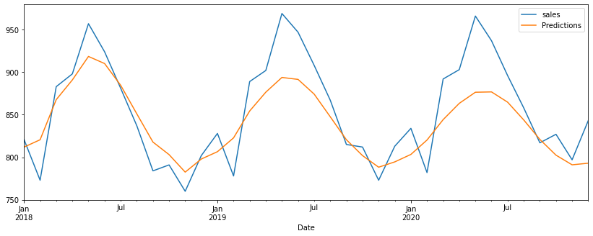
Prediction
Mean Squared Error for RNN model is: 34.89124
Mean Absolute Deviation for RNN model is: 28.24806
MAPE for RNN Model is: 3.24391

Slide 17
Comparison and Discussion
Model Name | MSE | MAD | MAPE
Linear Regression | 27.23522 | 23.5036 | 2.78069
Holt’s Winter Model | 32.38790 | 29.31068 | 8.55139
SARIMA | 34.97381 | 32.68459 | 8.74879
LSTM | 34.89124 | 28.24806 | 3.24391
From the Table-1 we can see different forecast error metrics of all four models. Linear Regression performs better in all parameters for this given dataset with MSE of 27.23522 ,MAD of 23.5036 and MAPE of 2.78069%.
For comparing other three models considering Mean Absolute Percentage Error(MAPE) as a measure but not MAD and MSE.
As MAPE is independent of scale chosen and one can compare series with different scales.
Linear Regression > LSTM > Holt’s Winter model > SARIMA

Slide 18
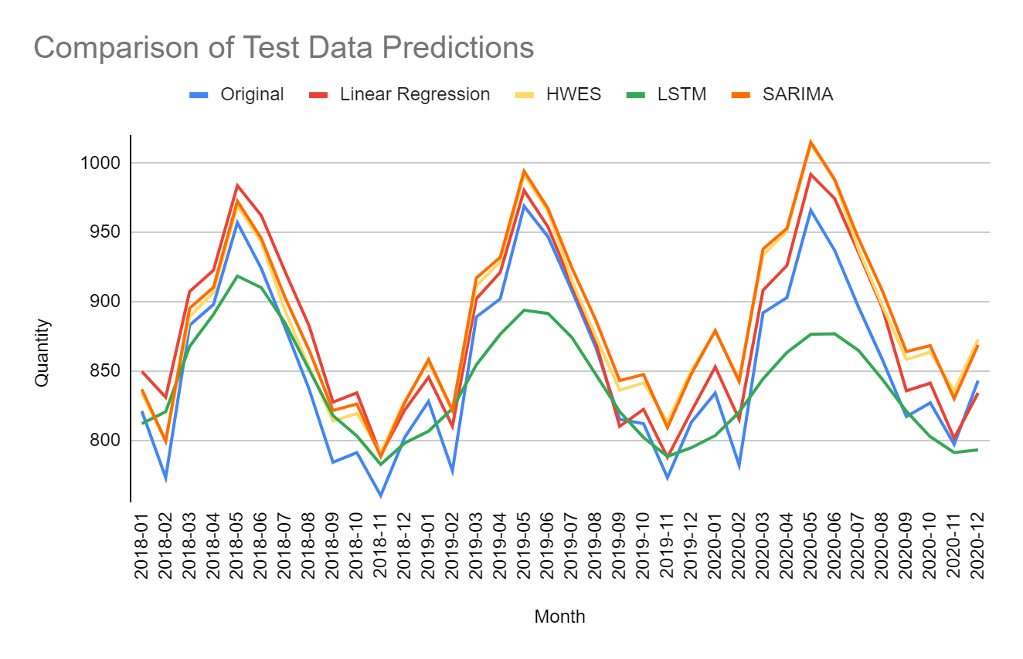
Comparison of Test Data Predictions of Four Models

Slide 19
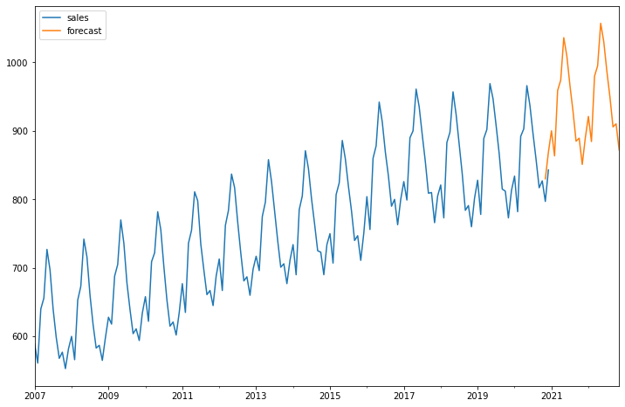
Future Sales Prediction for the Year 2021 and 2022

Slide 20
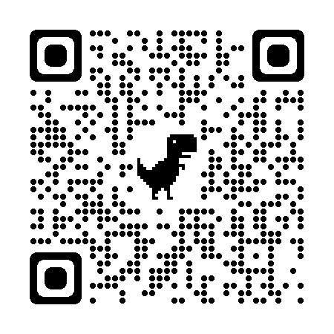
QR for my Git-hub Repo
https://github.com/chaitanya-bkc/Supply-Chain-Management-Project

Slide 21

Thank You

